Slide 1

Lecture 8
Try Catch vs Exception

Slide 2
class Example
{
public static void main (String[] args)
{
int[] arr = new int[4];
try
{
int i = arr[4];
System.out.println("Inside try block");
}
catch(ArrayIndexOutOfBoundsException ex)
{
System.out.println("Exception caught in catch block");
}
finally
{
System.out.println("finally block executed");
}
System.out.println("Outside try-catch-finally clause");
}
}

Slide 3
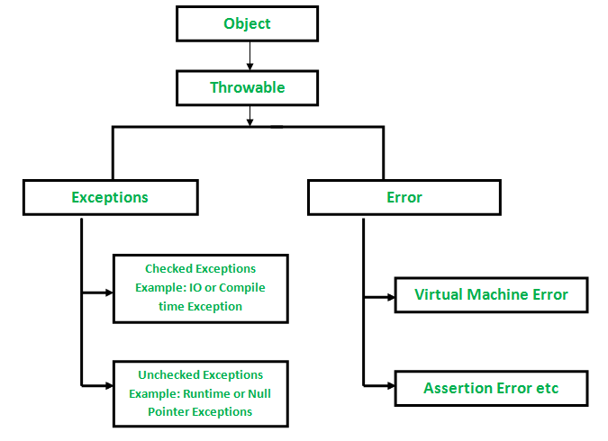

Slide 4
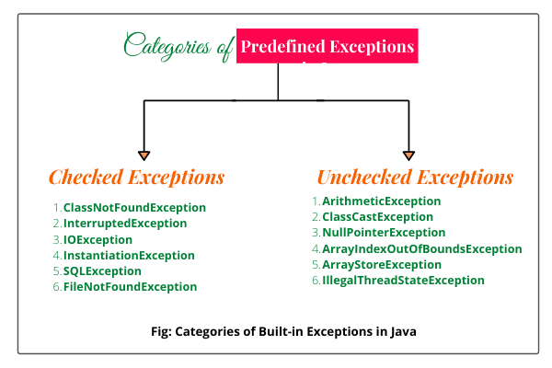

Slide 5
